Slide 1
Market Summary

Slide 2
1:General Profile summary
2:Regression summary
Catalog

Slide 3
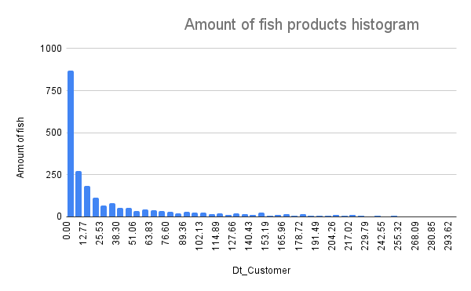
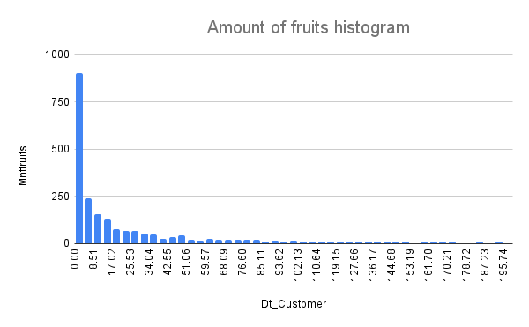
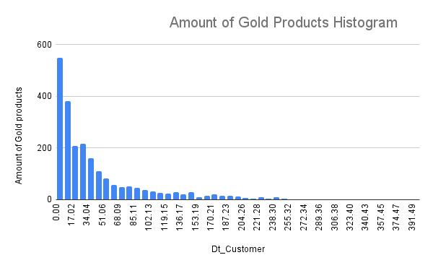
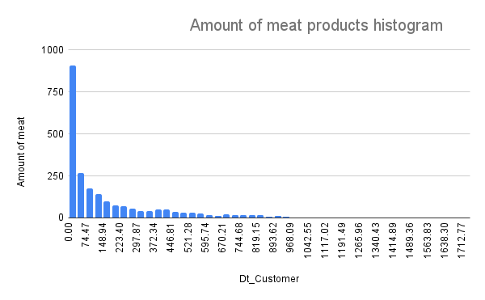

Slide 4
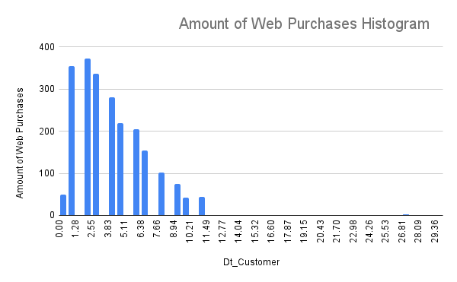
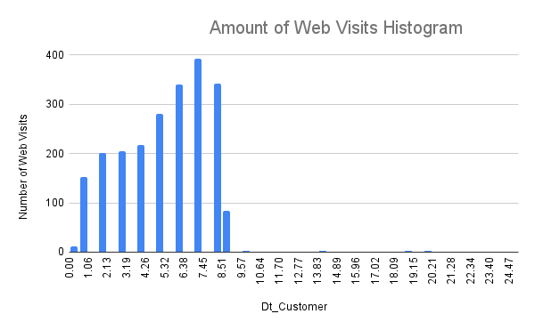
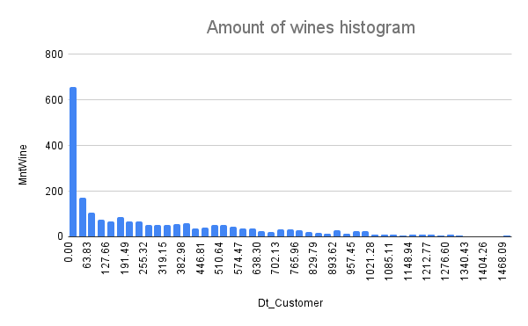
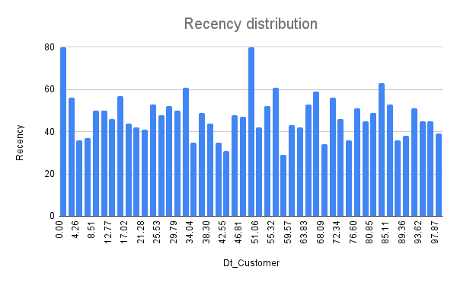
Back to Catalog

Slide 5
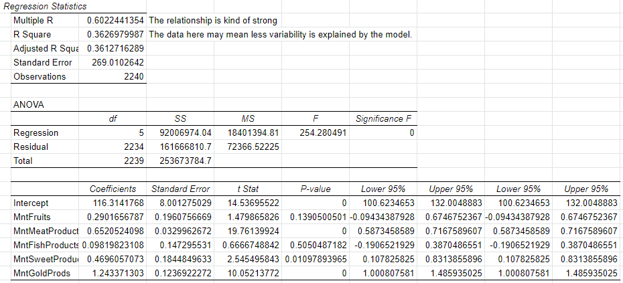
Regression Data with respect to Amount of Wines

Slide 6
Analysis of Regression model of Amount of Wines
As we can see here that all the Coefficients are positive, this means that as the value of the independent variable increases, the mean of the dependent variable also tends to increase. For example, while holding factors other than the Amount of Fruits constant, as the Amount of Fruits increase by 1(amount), the the Amount of Wines increase by 0.29. I mean relatively small. We can see the the Amount of Gold Products affect the most, which kind of make sense since Gold Product is expensive, which let people by more wine. For the standard error, we can see that the Amount of Meat Product does not case variation that much. And with the P value, only the Amount of Fish Products is not statistically significant with the the Amount of Wines. This means the relationship between the Amount of Wines and the Amount of Fish Products observed in the sample was unlikely to have occurred unless there really is a relationship in the population.

Slide 7
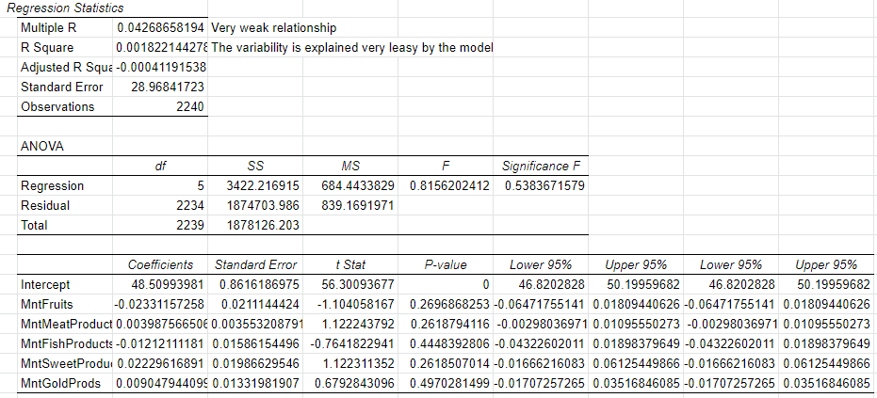
Regression Data with respect to Recency

Slide 8
Analysis of Regression model of Recency
As we can see here that some coefficients are positive, this means that as the value of the independent variable increases, the mean of the dependent variable also tends to increase. Some are negative, which is opposite. Variables like amount of fruits and fish products has negative relationship with Recency, this means customers does not buy a lot of fruits products and fish products online, which makes sense since they need to be fresh. Other variables like amount of Gold Products are more likely to cause customers to buy online. For the standard error, we can see that the Amount of Meat Product does not case variation that much, while others cause the variation a little with this regression line. And with the P value, all variables are not statistically significant with the the Amount of Wines. This means the relationship between tall the independent variables and Recency observed in the sample was unlikely to have occurred unless there really is a relationship in the population.
Back to Catalog

